Slide 1



E WASTE GENERATION CLASSIFICATION

Slide 2

Learning Objectives
Understand the e-waste problem
Work with image datasets (folder-structured)
Use EfficientNetV2B3 with transfer learning
Fine-tune and evaluate a CNN model
Deploy using Gradio & Streamlit
GOAL
Goal
“To automate e-waste image classification using deep learning and deploy a model that enhances sustainable recycling practices.”

Slide 3
Tools and Technology used
Tool / Technology | Usage / Description
Python 3.x | Core programming language used for all stages of development including model training.
TensorFlow & Keras | Frameworks used to build, fine-tune, and evaluate the deep learning classification model.
EfficientNetV2B3 | Pretrained CNN used for transfer learning to extract high-quality features from images.
Jupyter Notebook | Development environment for writing, testing, and documenting code interactively.
Pillow (PIL) | Library for loading and converting image files (e.g., JPEG/PNG to RGB format).

Slide 4
Tools and Technology used
Tool / Technology | Usage / Description
Gradio | Library used to create an interactive model interface during local development.
Streamlit | Web framework used to deploy the model as a real-time classification web application.
NumPy | Used for numerical operations on image arrays before feeding them into the model.
CSV (Logging) | Used to store metadata of flagged images (e.g., prediction result, time, filename).
Matplotlib | Used for plotting graphs like accuracy/loss during model evaluation and debugging.

Slide 5
Methodology
Dataset Collection – Gathered ~3000 labeled e-waste images across 10 categories from a public Kaggle dataset.
Image Preprocessing – Resized, normalized, and augmented images for improved model performance and generalization.
Model Building – Applied transfer learning using EfficientNetV2B3 with a custom classification head.
Training Strategy – Fine-tuned the model with dropout and early stopping to prevent overfitting.
Model Evaluation – Assessed the model using accuracy, loss, confusion matrix, and classification metrics.
Deployment – Built a real-time Streamlit web app for image upload, prediction, and result display.
User Interaction Features – Logged flagged images with confidence & timestamo in .csv for feedback loop.

Slide 6
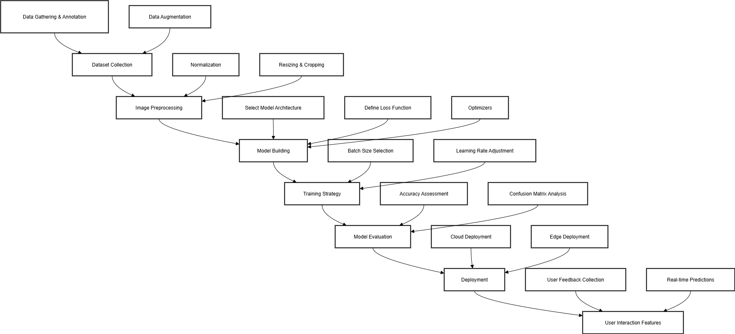
Methodology

Slide 7
Problem Statement:
Electronic waste (e-waste) is a rapidly growing global concern for both environmental and public health. Discarded electronic devices contain both valuable resources and hazardous substances, leading to contamination and health risks if improperly processed. Manual classification for recycling is labor-intensive, prone to errors, and inefficient. This project aims to establish an automated e-waste classification system using artificial intelligence and machine learning, enabling accurate and rapid identification to streamline recycling and promote sustainable waste management.

Slide 8
Solution:
Developed and deployed a high-accuracy image classification model using EfficientNetV2B3 with Streamlit, enabling real-time e-waste prediction, user interaction, and feedback logging for smarter recycling.
Model Architecture → Used EfficientNetV2B3 with transfer learning to classify e-waste images into 10 categories.
Training & Optimization → Applied data augmentation, dropout, and early stopping to improve accuracy and prevent overfitting.
High Accuracy Performance → Achieved 96% test accuracy with strong precision and F1-scores across all classes.
Real-Time Web Deployment → Built an interactive Streamlit app that predicts e-waste categories from uploaded images instantly.
Feedback & Logging System → Integrated a flagging feature that logs low-confidence predictions for model improvement.
Scalability & Usability → Lightweight solution suitable for deployment in recycling centers or educational platforms.

Slide 9
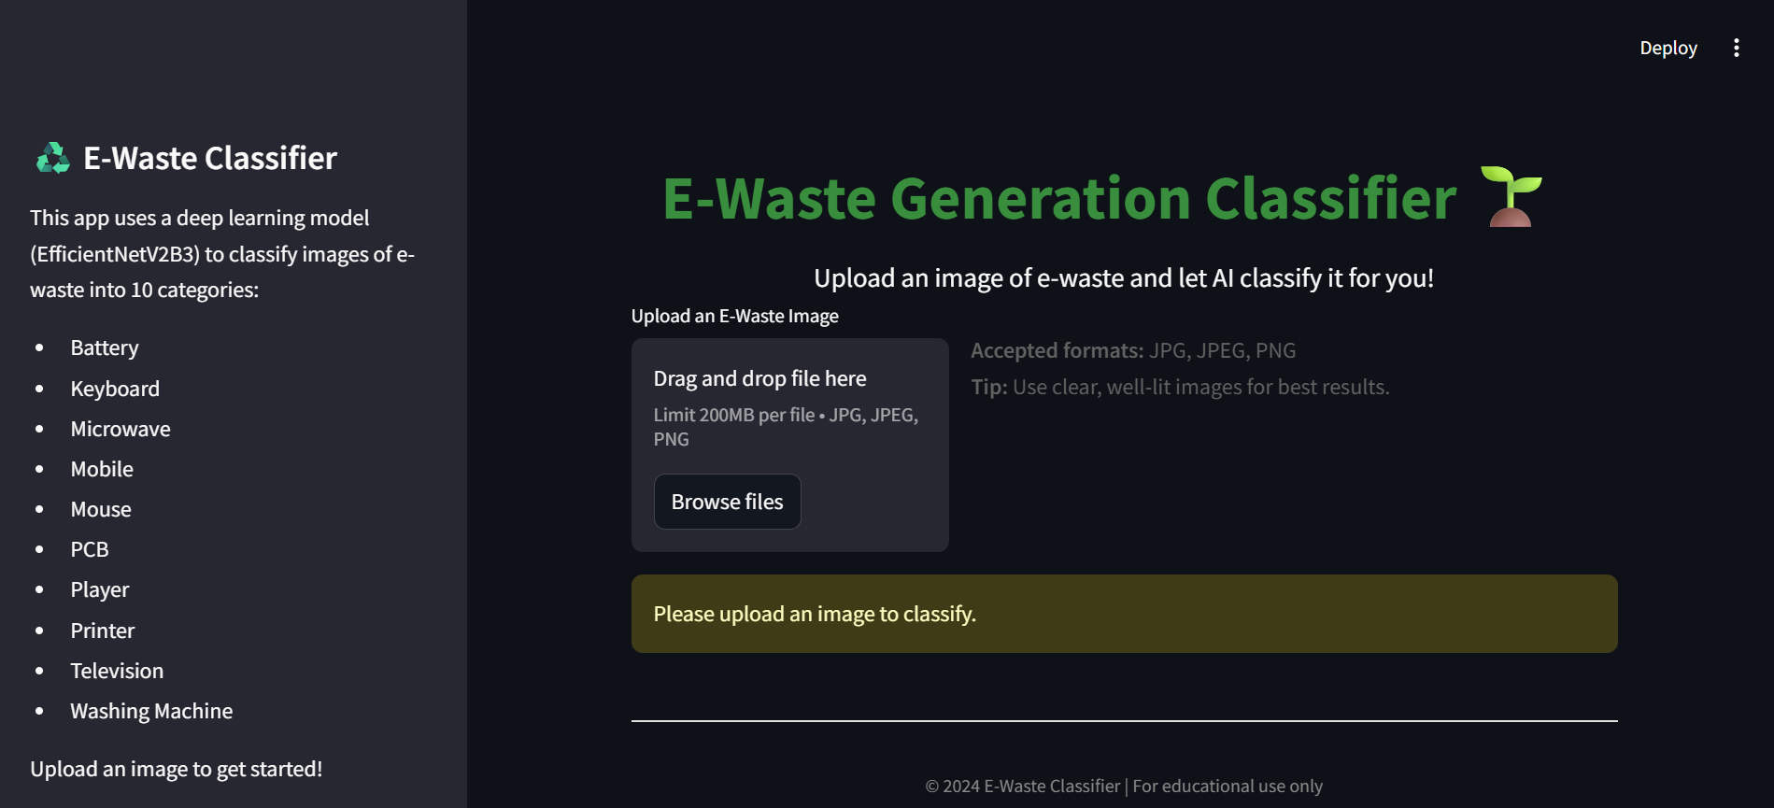
Screenshot of Output:
The Streamlit interface provides an intuitive platform for users to upload e-waste images and receive real-time classification results with confidence scores.

Slide 10
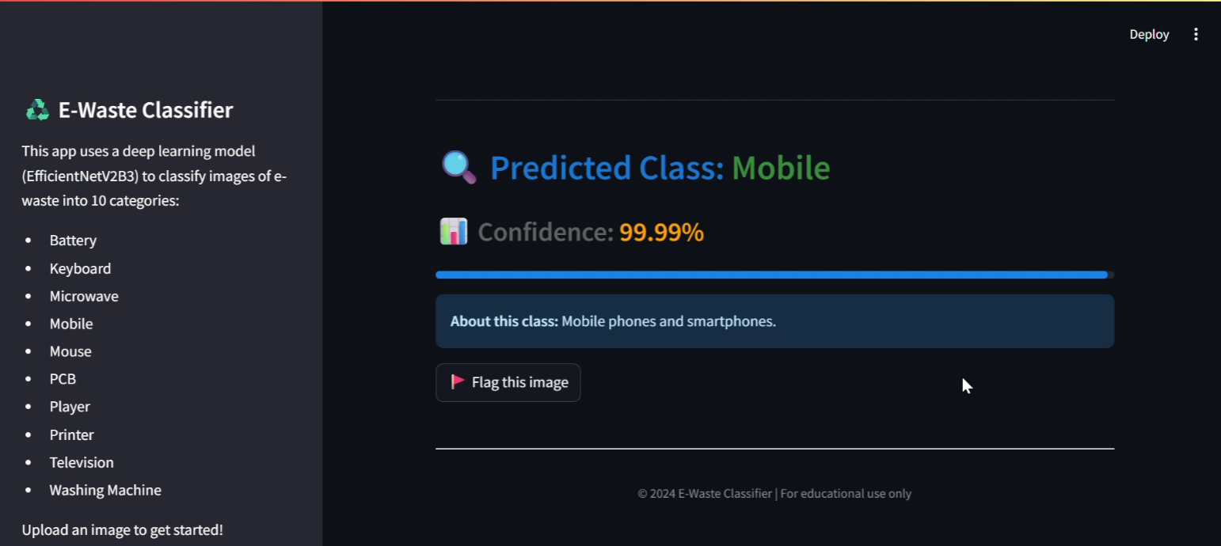
Screenshot of Output:
The Streamlit app displays the uploaded e-waste image, predicts its category with confidence, and allows users to flag uncertain results for feedback and improvement.

Slide 11
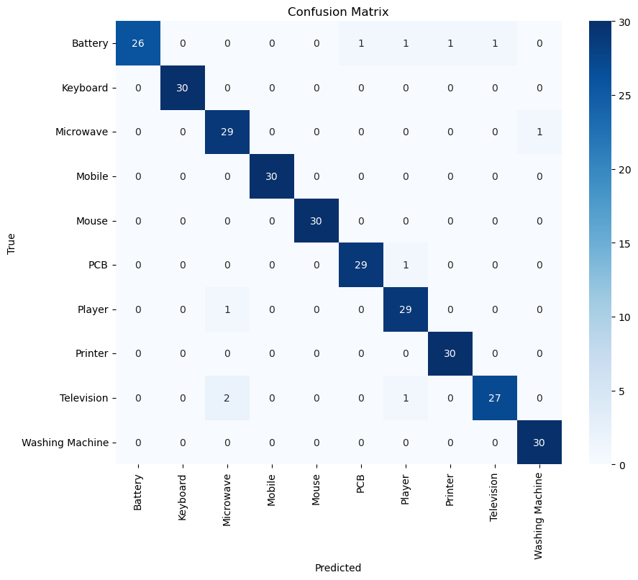
Evaluation Metrics
The model exhibits excellent generalization, with consistent metrics across all classes, proving its reliability for real-world use.
Train Accuracy: 99.08%
Validation: 96%
Test Accuracy: 96%
Test Loss: 0.1073
F1-scores: 0.92–1.00 across all classes

Slide 12
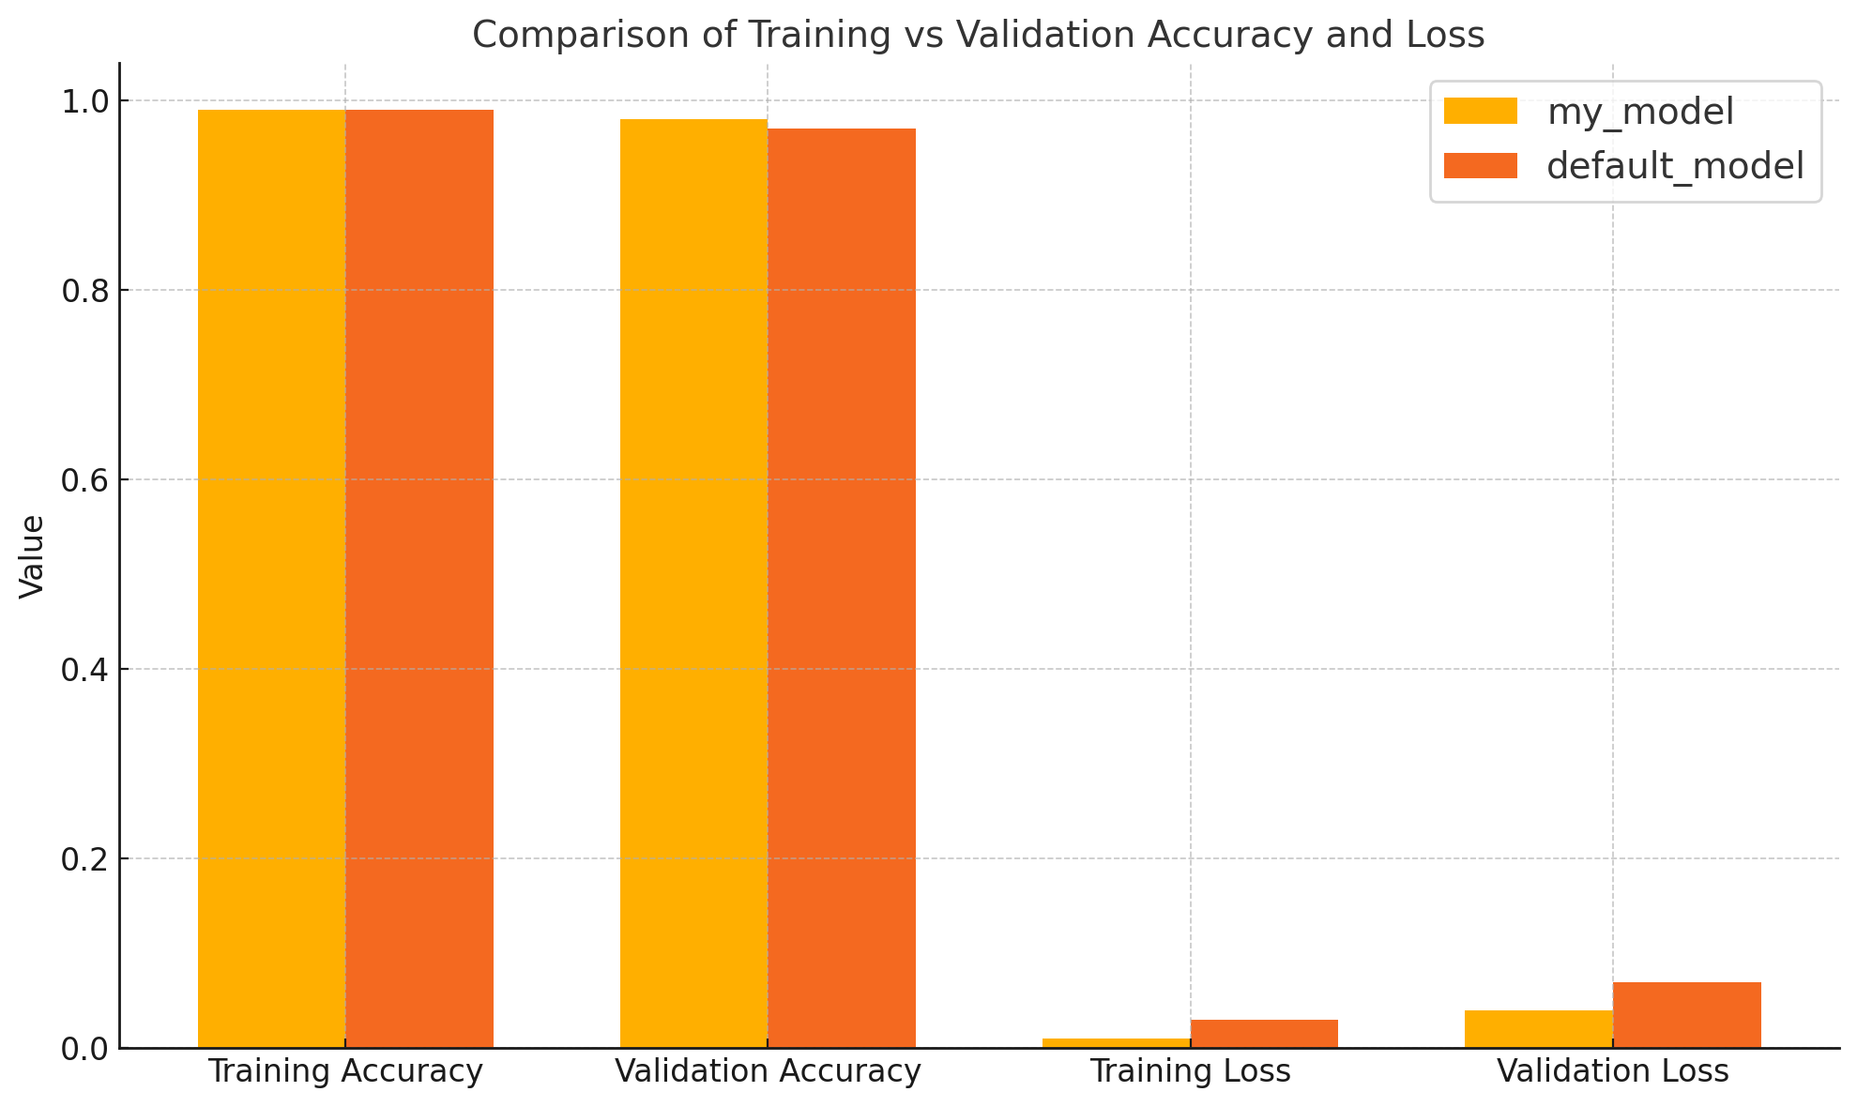
Model Optimization Results
Comparison of training and validation accuracy and loss between my model and baseline-model, showing slightly better performance by the model trained by me.

Slide 13
Real World Impact
Promotes Sustainable Waste Management → Encourages responsible recycling by automating the identification of electronic waste categories.
Reduces Manual Effort and Human Error → Minimizes the need for labor-intensive and error-prone manual sorting in e-waste facilities.
Accelerates Sorting Efficiency in Recycling Plants → Enables faster and more accurate classification of waste materials at scale.
Supports Smart City & Clean-Tech Initiatives → Aligns with green technology goals by integrating AI in environmental management systems.
Educational Tool for Awareness & Training → Can be used in schools, colleges, or awareness programs to teach e-waste identification and sustainability.

Slide 14
Conclusion:
This project successfully developed a deep learning-based image classifier using EfficientNetV2B3 for accurate e-waste identification.
The model achieved a 96% accuracy on unseen test data and demonstrated strong generalization across 10 distinct e-waste categories.
A user-friendly Streamlit web app was created for real-time image upload, prediction, and confidence visualization, making the solution practical and accessible.
A flagging and feedback system was implemented, allowing continuous data collection for future retraining and accuracy improvements.
The project shows how AI can play a vital role in promoting sustainability, automating recycling processes, and contributing to environmental protection.
With further enhancements such as IoT integration, multi-object detection, or mobile app deployment, this solution has strong potential for real-world adoption.

Slide 15
Github link : https://github.com/sharath-1212/Final-Submission
Thank You for Your Time and Attention! Feel free to ask questions or share feedback.
"Together, let's build smarter and greener solutions for a sustainable future."

